Slide 1
Data
Sam & Stefan
January 22, 2016

Slide 2
Newspaper Data
Scans come from Newspapers.com
Pittsburgh
Cincinnati
Detroit
1783 - 2011

Slide 3
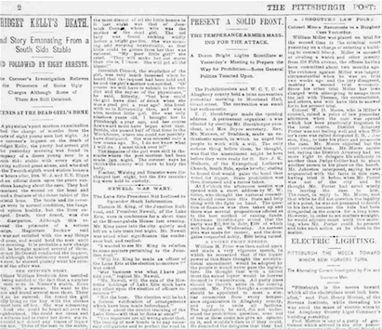

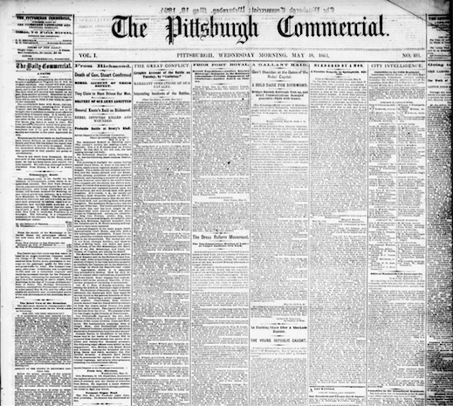
Space of Images
Order – Disorder
x-axis
Quality
y-axis

Slide 4
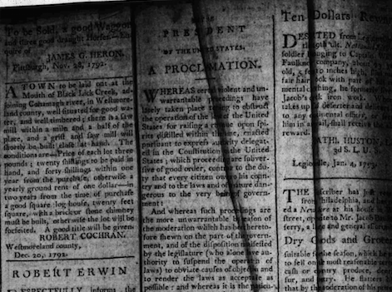
Quality: Low
(1783) shadow, creases, curvature

Slide 5
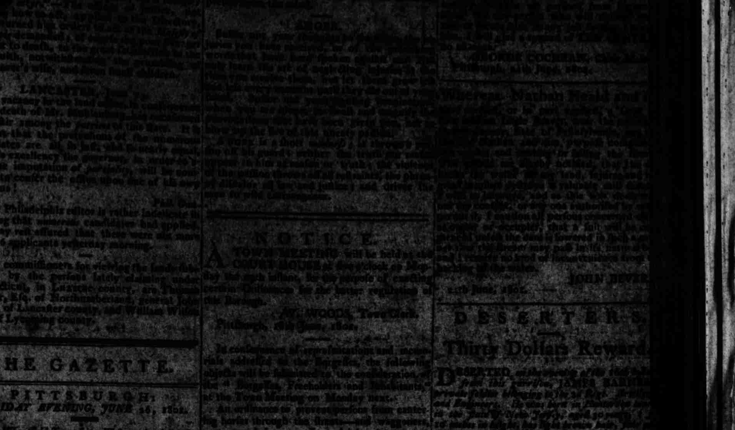
Quality: Low

Slide 6
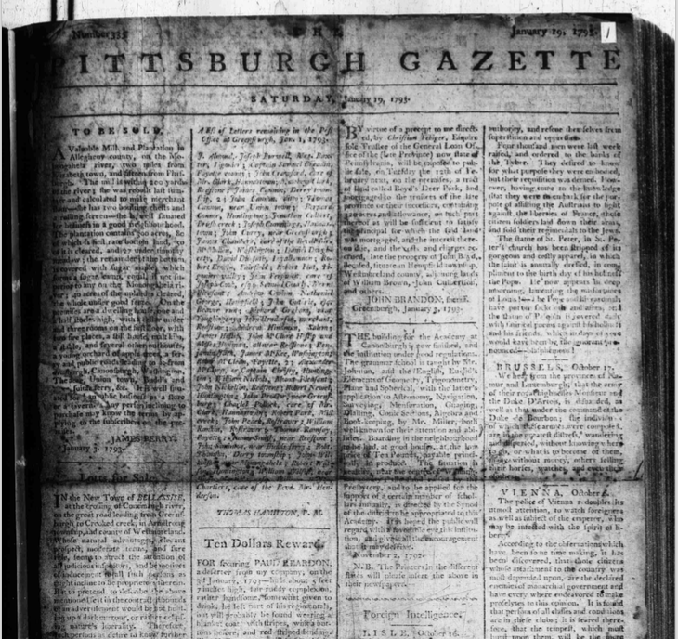
Quality: Low
(1783) shadow, folds

Slide 7
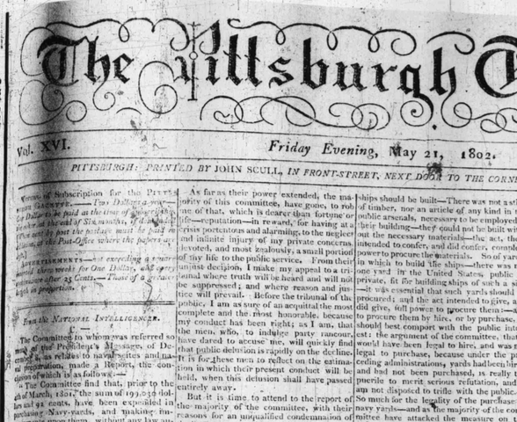
Quality: Low
(1802) Noise and curvature

Slide 8

Quality: High

Slide 9
Disorder: High

Slide 10
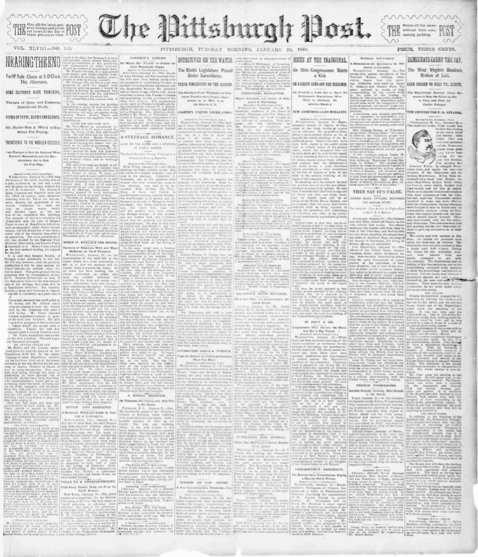
Disorder: Low

Slide 11
Possible Pitfalls
Poor-quality scans
Matching titles to articles
Article levels
Advertisements

Slide 12
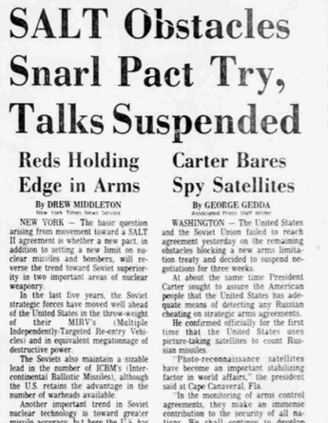
Matching titles to articles
To which article do we assign the main title?

Slide 13
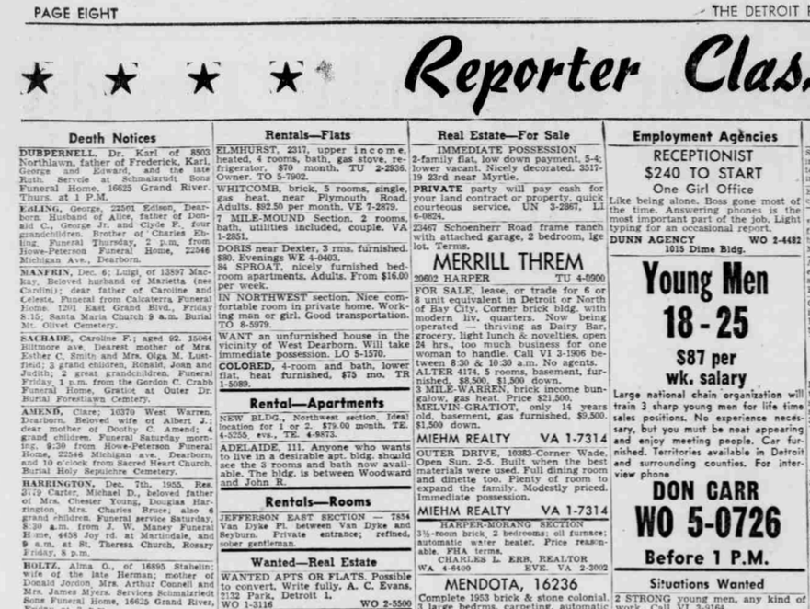
Article Levels

Slide 14
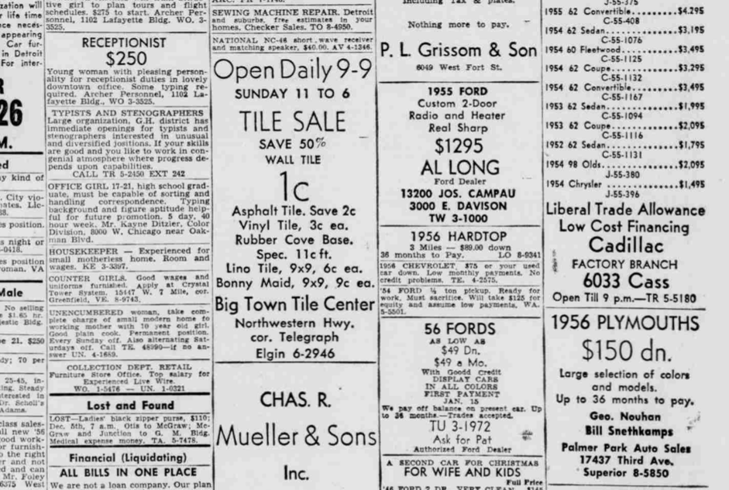
Article Levels
classifieds

Slide 15
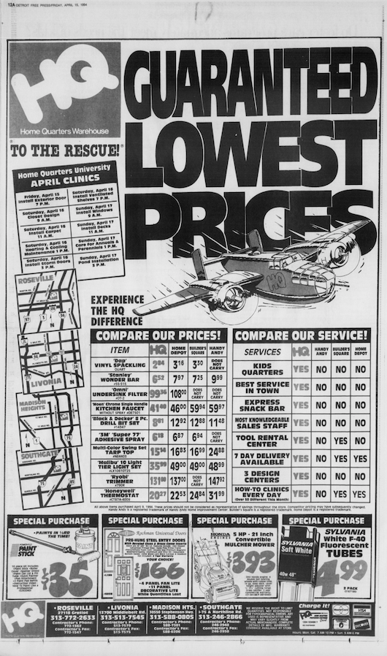
Advertisements
Full-page advertisement

Slide 16
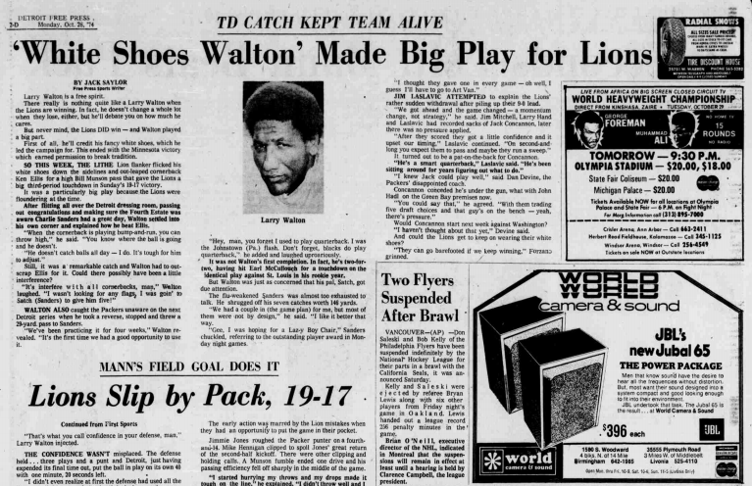
Advertisements

